Slide 1

Azure Synapse Data Explorer
Distributed storage & query engine optimized for log & telemetry data

Slide 2

Telemetry Data: Key to the Digital Transformation
50B
IoT
175ZB
Logs
Events
connected devices by 2030
Time Series
Click Stream
total amount of data by 2025
Connected Devices
SIEM
Smart Buildings
Security
Smart Factories
Historians
Notes:
Telemetry data is everywhere – we find it in IOT Sensors, logs, click streams – it drives advances in the connected devices we find in our homes, smart buildings, smart factories,
and in devices that consumers and businesses rely upon.
Telemetry data is fueling digital transformation.
Source of 50B\175ZB data: Satya Nadella Explains How Microsoft Is Fueling Tech Intensity In India At Future Decoded: Tech Summit 2020 (analyticsindiamag.com)

Slide 3

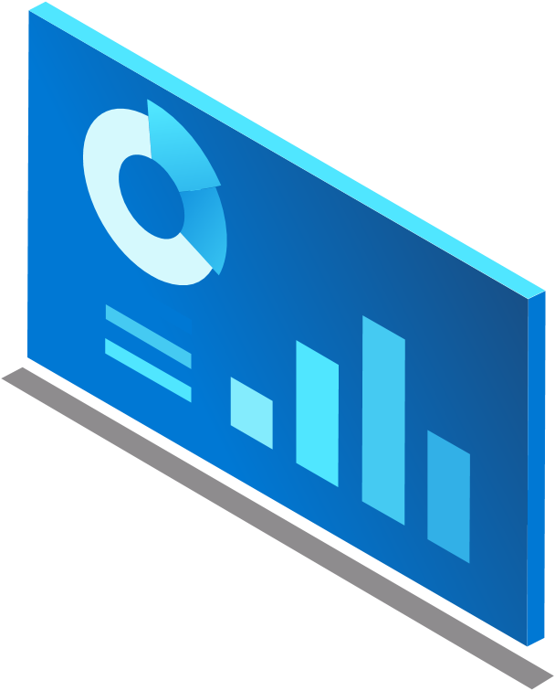
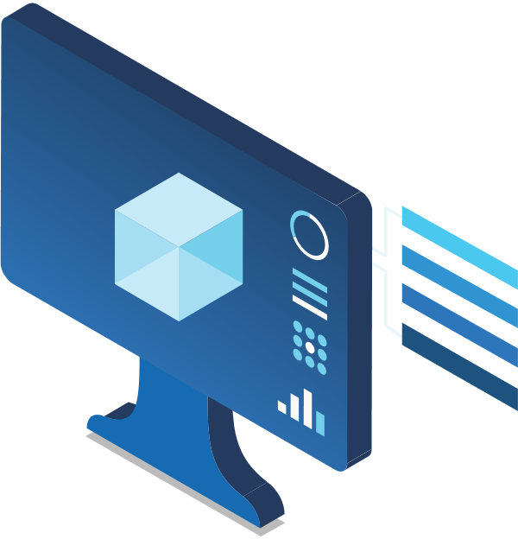
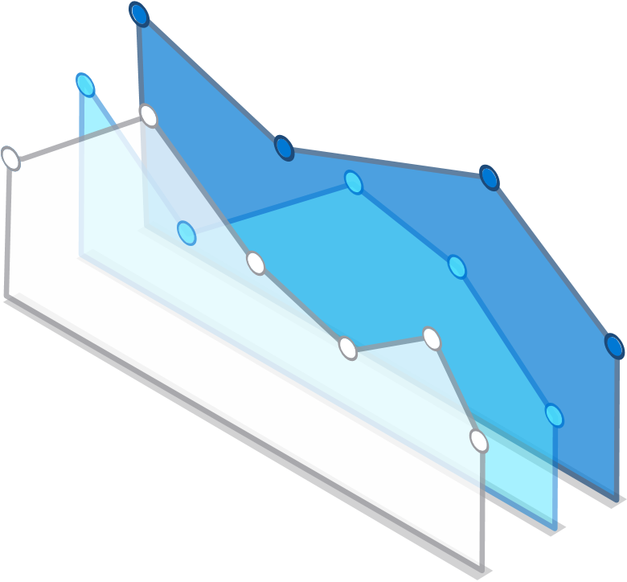

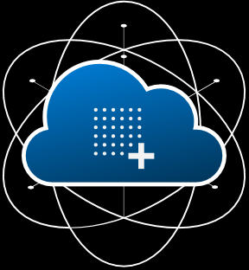
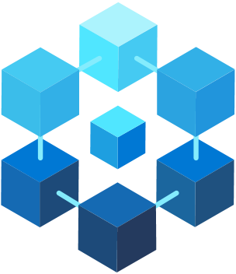
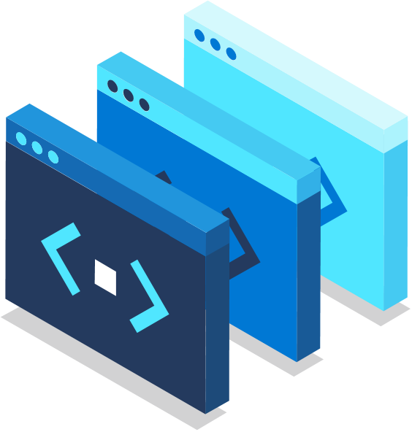
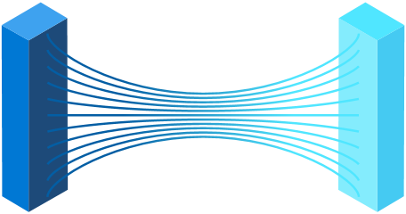
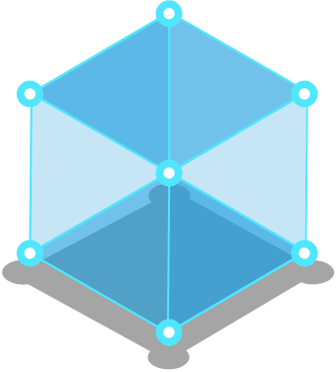
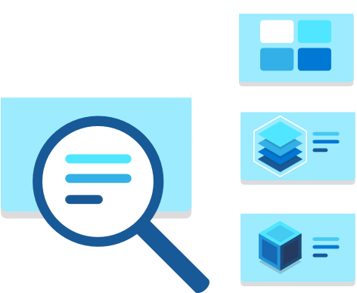
Connecting data & unlocking insights is key
Smart Factories
Smart Buildings
Connected Devices
Time Series
Logs
IoT
Events
Click Stream
SIEM
Security
Historians
Notes:
Connecting data and unlocking insights is critical to the success of digital transformation

Slide 4
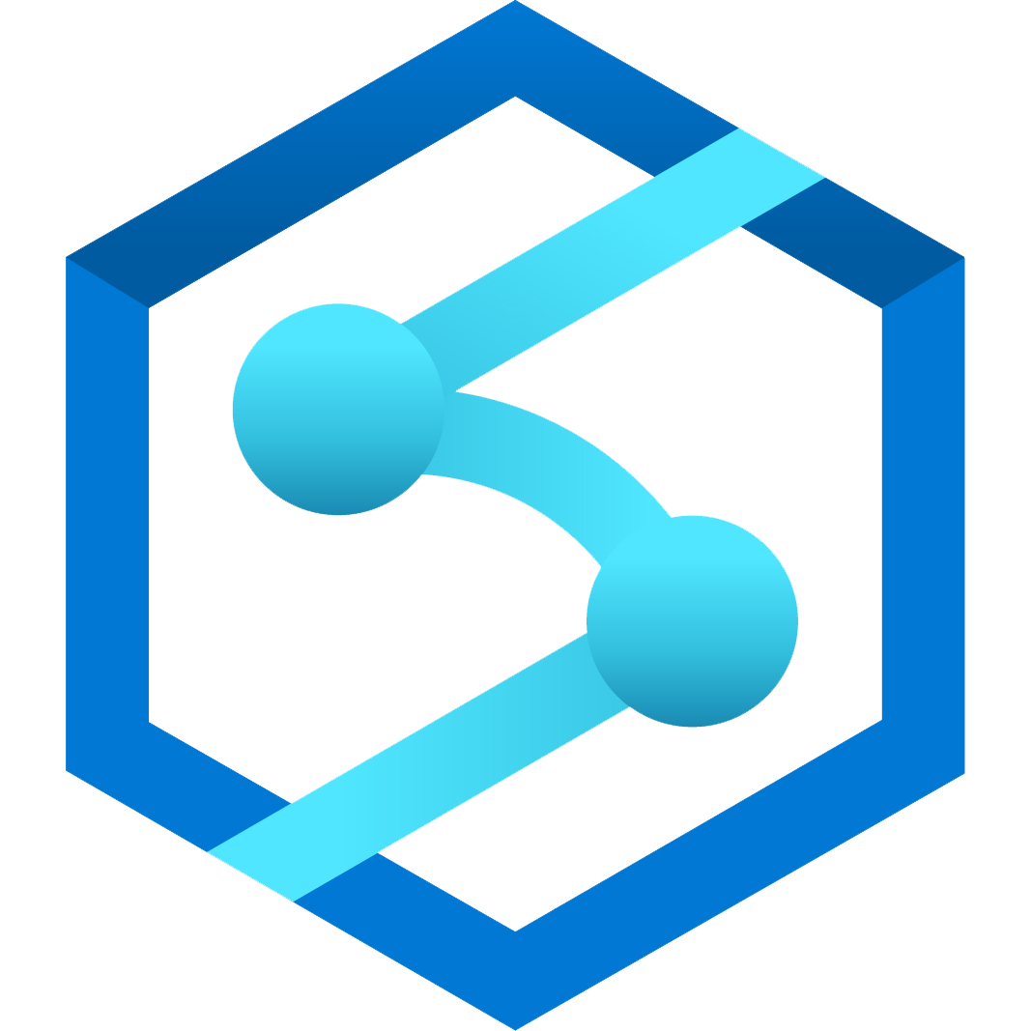
Azure Synapse data explorer
Distributed storage & query engine optimized for log & telemetry data
Notes:
Introducing Azure Synapse data explorer, it’s a distributed storage and query engine optimized for log and telemetry data.

Slide 5
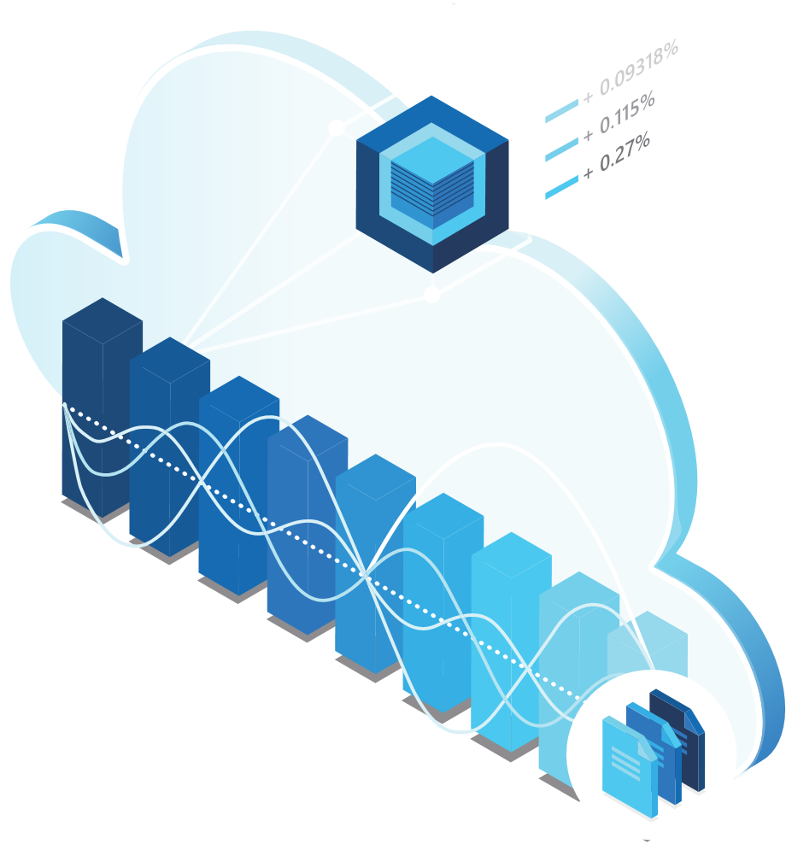
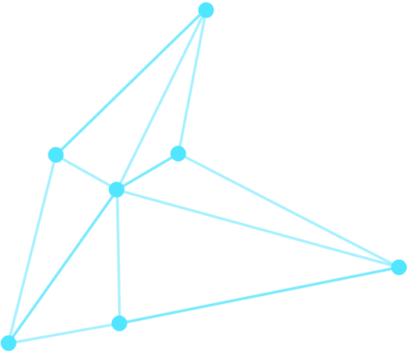

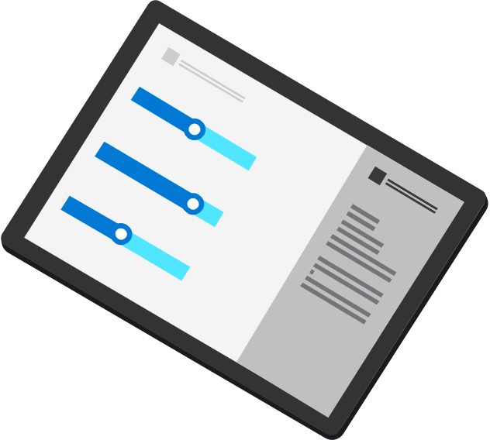
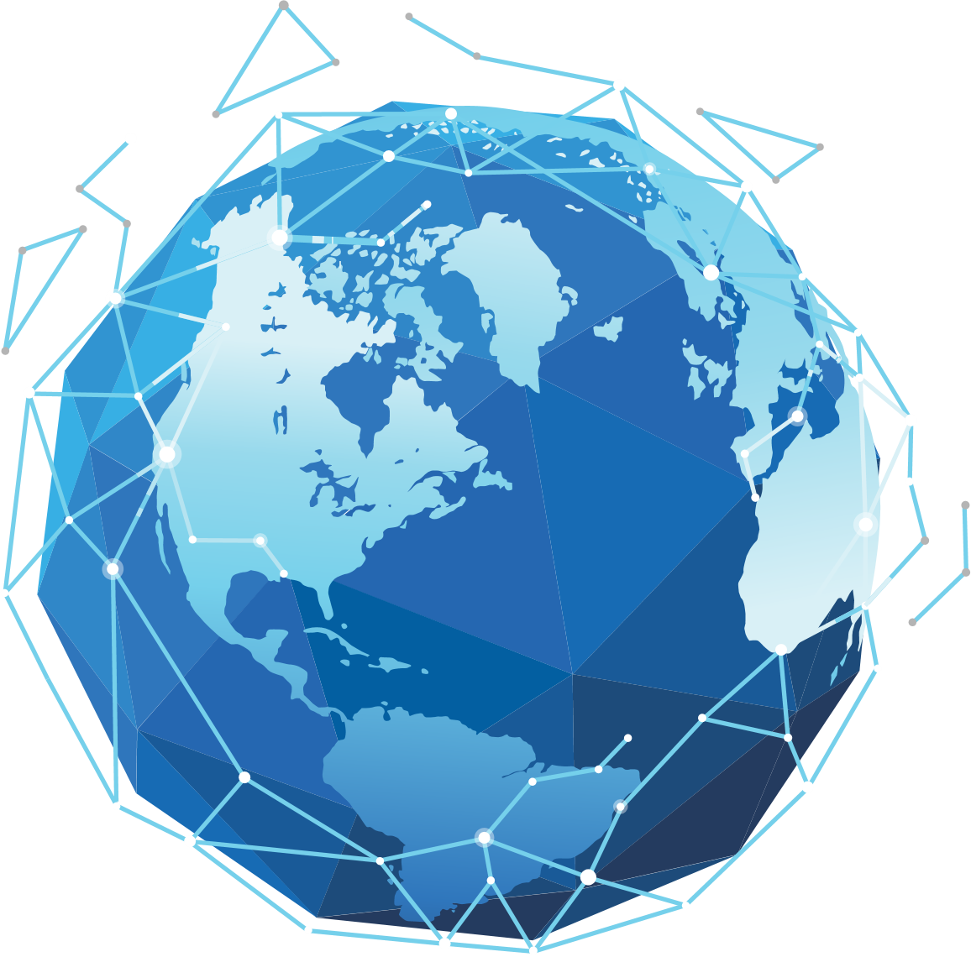
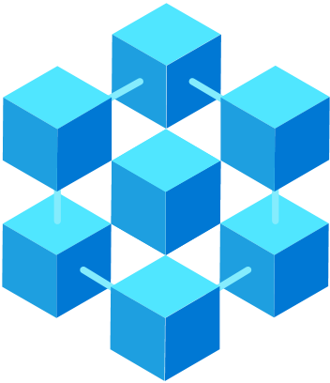

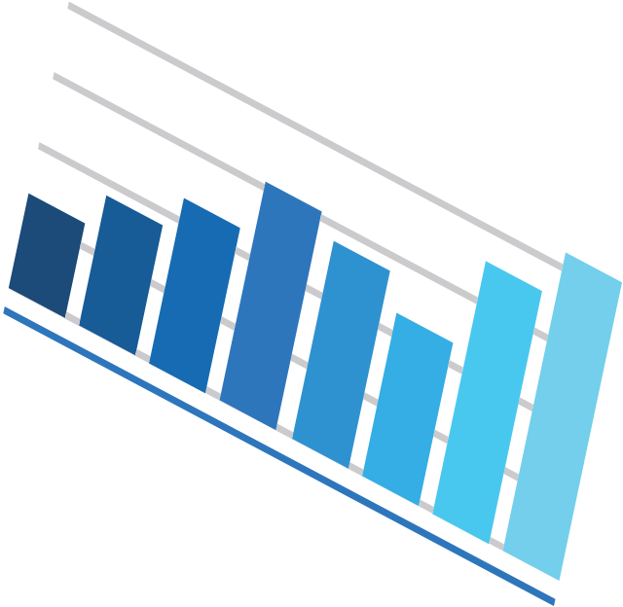
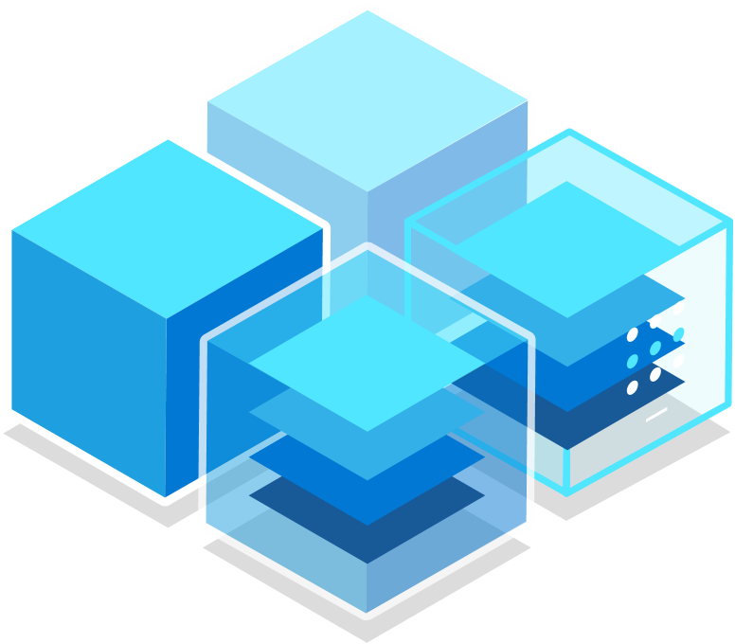
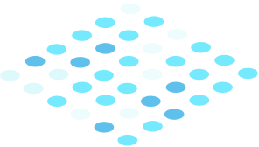
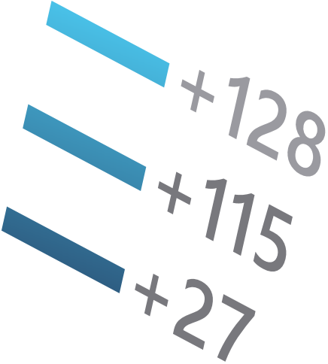
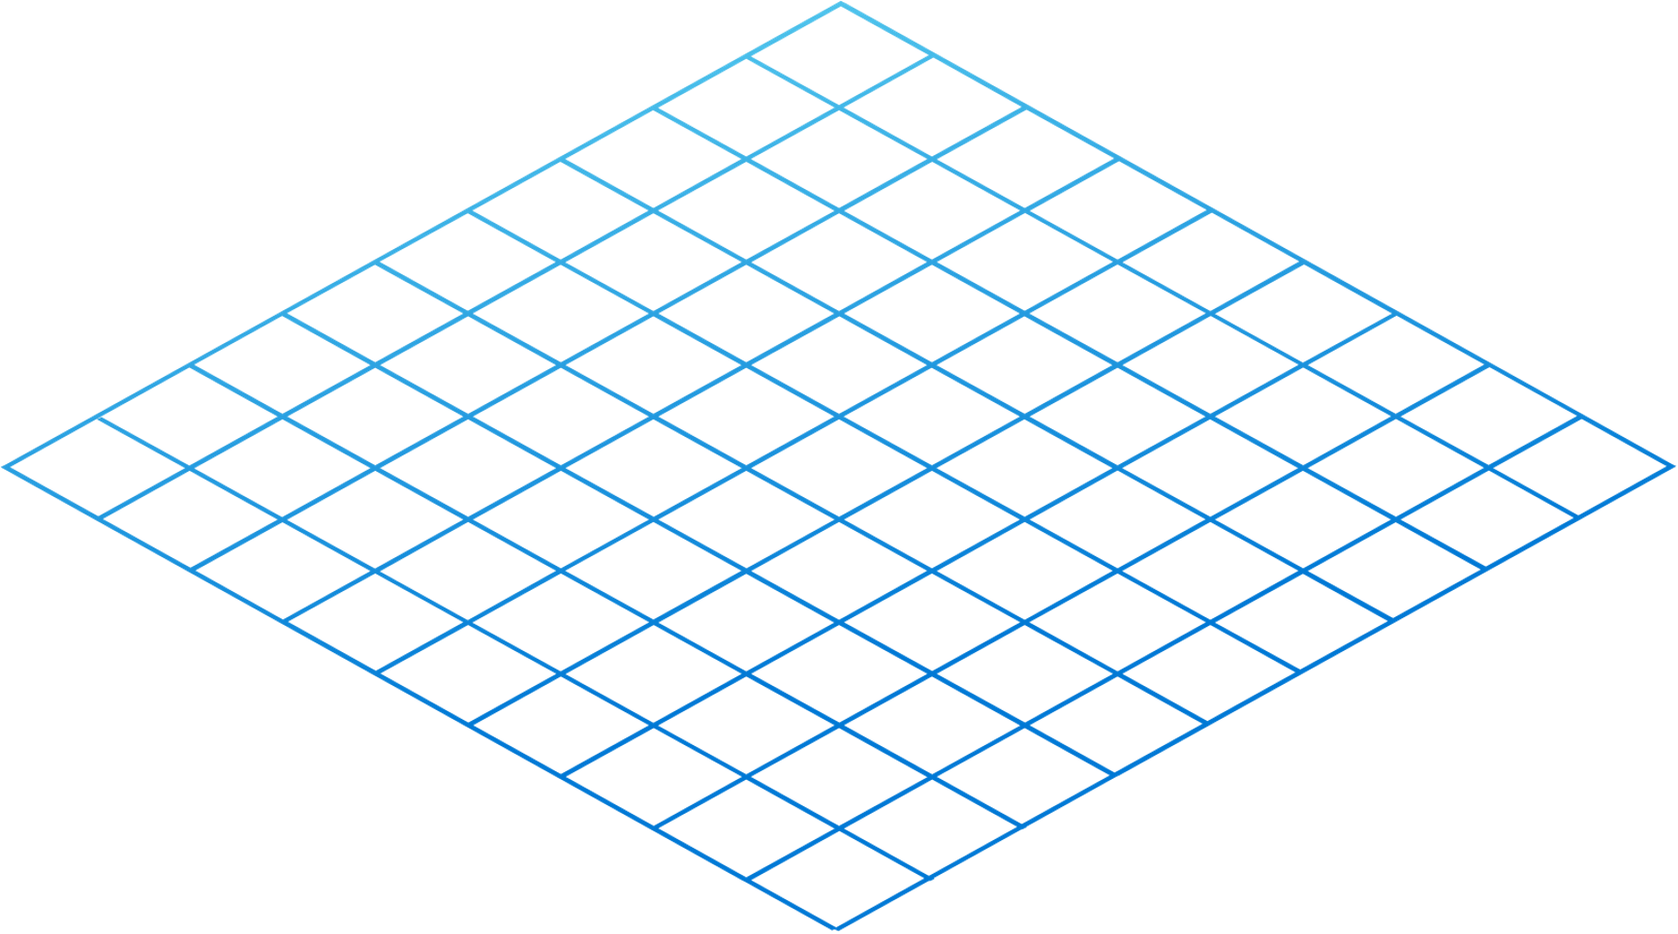
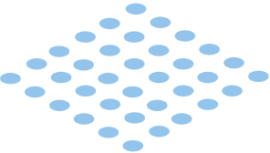
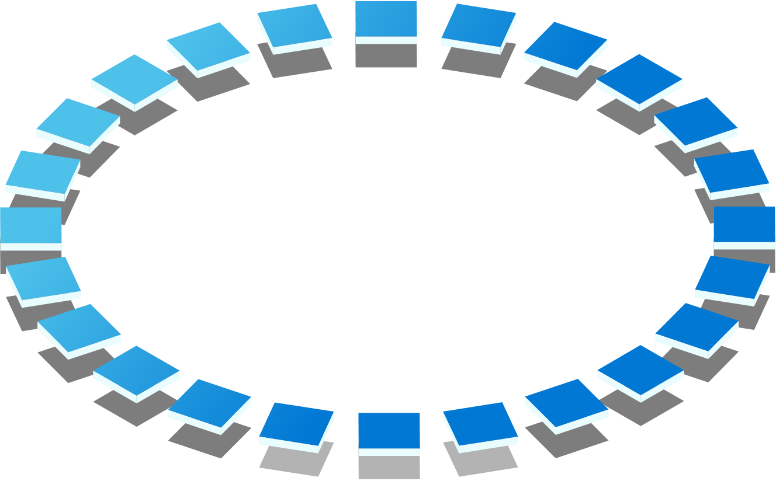
Key pillars of Azure Synapse data explorer
1
Near real-time insights on big data
Optimized engine to interactively query on log data
Integrated cloud data platform for time series and IoT data
Automated scaling from Gigabytes to Petabytes
Notes:
Get Near real-time insights on your big data as its’ been ingested
Data Explorer engine is optimized for indexing text data that enables you to run queries on log data
Its an integrated cloud data platform for time series and IoT data, providing integrations with IoT Hub, Digital Twins, and IoT Central
It automatically scales to meet your workload from Gigabytes to Petabytes

Slide 6
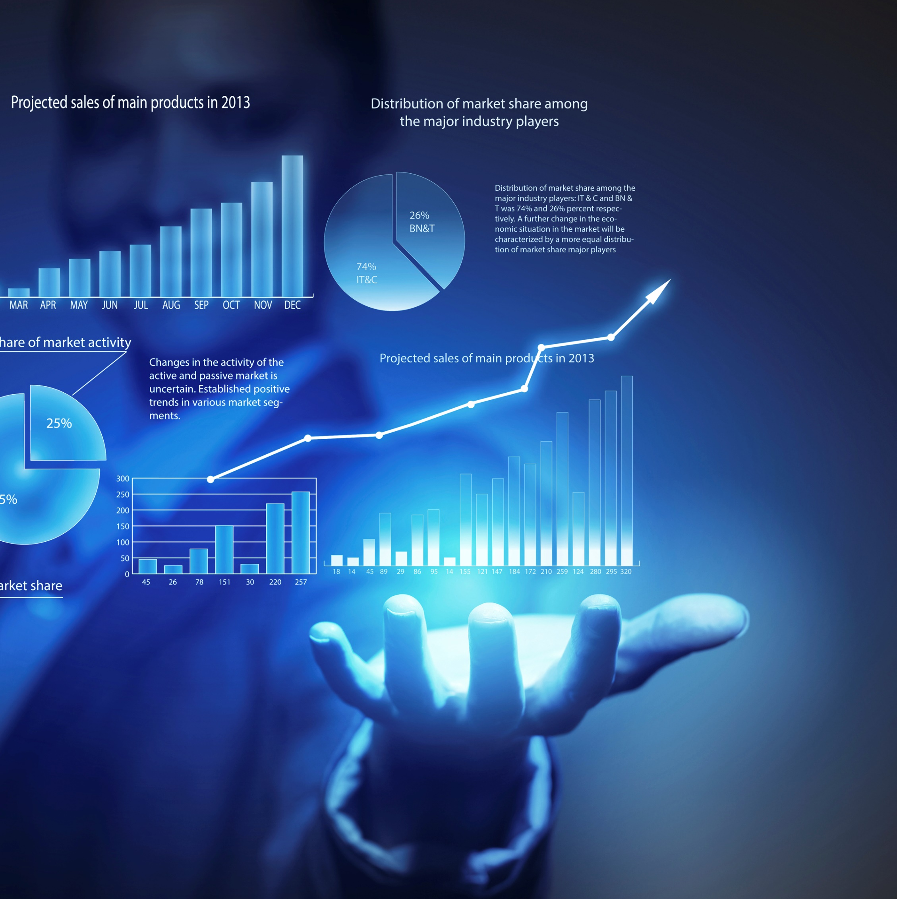

Scenarios
Building near real-time Big Data analytics on custom event/logs data
Security log analytics
IoT analytics solutions
ISV workloads
Centralized near real-time observability solutions from all telemetry sources
Notes:
Building near-real-time Big Data analytics on custom event\logs data
For Examples,
A telco company ingesting TBs of data every day on their subscriber call data, network data, etc. and analyzing it to improve subscriber experience.
A major Oil & Gas company ingesting millions of credit transaction logs to analyze the health of payment systems on gas stations.
A large media company ingesting TBs of CDN data to analyzing and improve the live streaming experience for their subscribers.
A large logistics company ingesting millions of shipment tracking records and analyzing it.
Build centralized near-real-time observability solutions for all telemetry sources
You can centralize your log data and building solutions to meet your scale
Security log analytics
Companies org/collect logs. User it for observability (how infra/software is working); logs used to analyze security of environment. Trying to find phishing, hacker, attacks, looking at network logs. Looking at IP addresses—traffic coming from it.
Customers migrating from Splunk SIEM to Sentinel and using Data Explorer to complement long term analytics
ISVs building security log analytics solutions
IoT analytics solutions
Customers and ISVs building IoT\Time Series solutions
Building cloud-based historians in combination of Data Explorer, Data Lake, Spark
Tons of use cases in connected devices, manufacturing, energy, oil & gas, automotive sector
Note: All Azure Data Explorer scenarios apply here, you can check the customer stories here: http://aka.ms/adx.stories

Slide 7
Common use cases across industries
1
Retail
Financial
Oil/Gas & Energy
Security
Web Analytics, IoT Analytics
Audit Logs
Industrial IoT, Historian, Time Series, Grid Analytics
Security Analytics, Threat Detection, SIEM
Healthcare
Advertising
Media Entertainment
Automotive
IoT device
Analytics
Personalized offers, campaign management
Content Delivery Network Analytics, Viewer Experience Analytics, Live Event Analytics
Manufacturing, Connected cars, Fleet management
Central Observability (Logs, Traces, Metrics) and Time Series
Notes:
There are various Log and Time Series across the industries

Slide 8

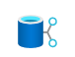


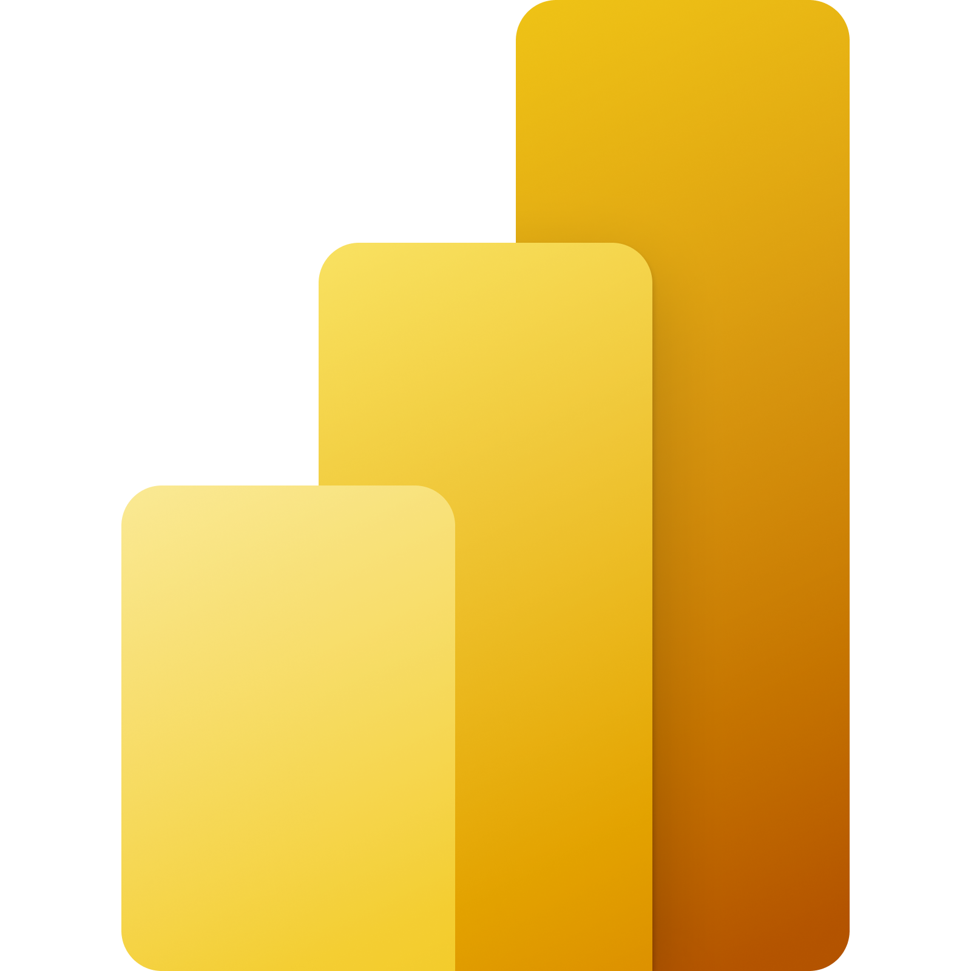
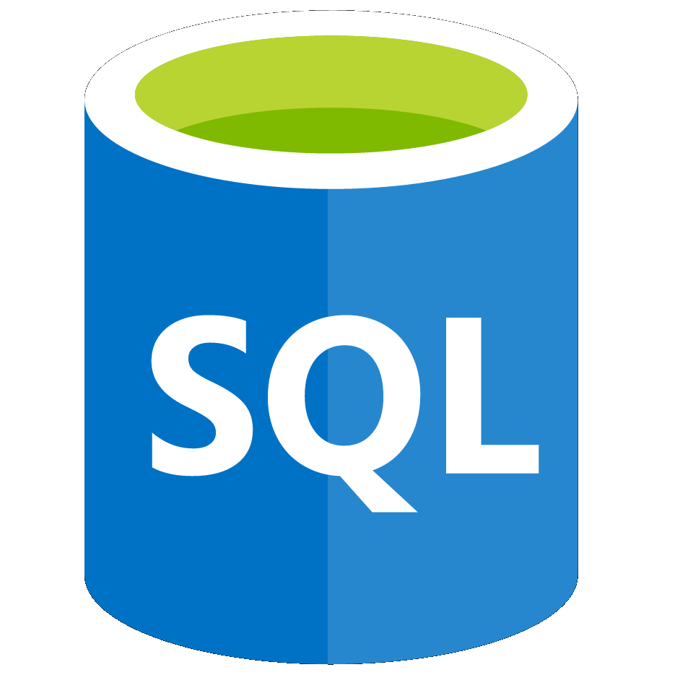


Run log & telemetry analytics seamlessly with Azure Synapse
Data Engineering - Data Warehousing - Data Science - Telemetry Analytics - Streaming Analytics - Intelligent Apps
Unified Experience
Azure Synapse Studio
On-prem
Integration
Management
Monitoring
Security
DevOps
Cloud data
Analytic runtimes
SQL
Data Explorer
Applications
Semantic Layer – Common Data Model
Streaming data
Data Warehouse
Data Lake
Event Brokers
Azure Synapse Link
Cosmos DB
Dataverse
Notes:
To complement our existing SQL and Apache Spark engines, the Azure Synapse data explorer engine is now part of Synapse ecosystem to enable you to run log and telemetry analytics seamlessly.

Slide 9
12
L200 level slides

Slide 10


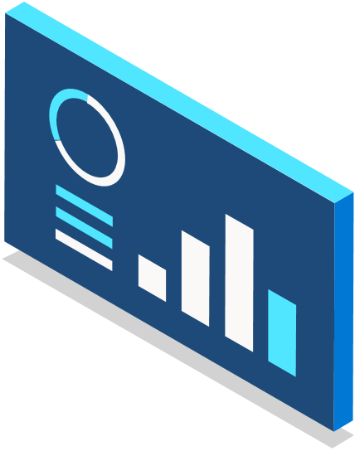
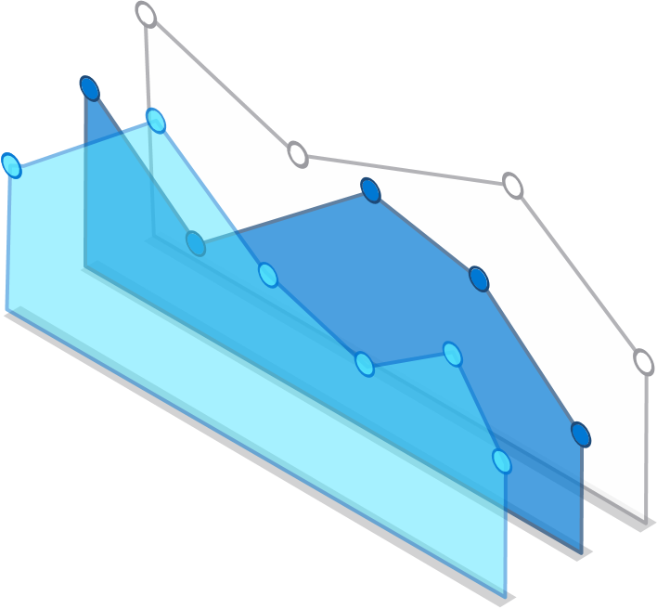
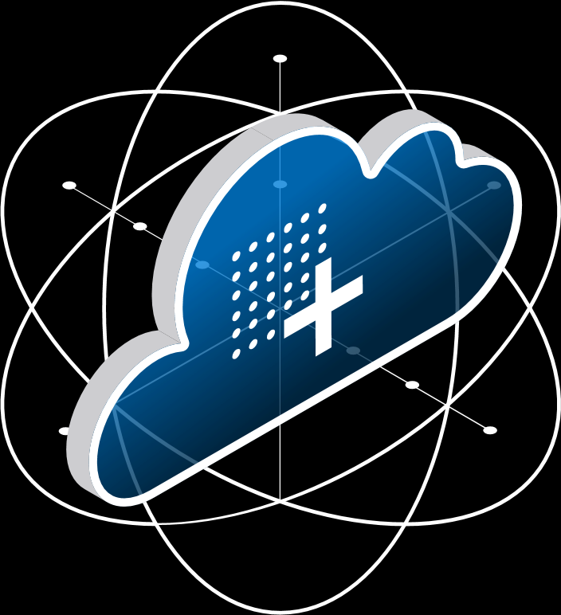
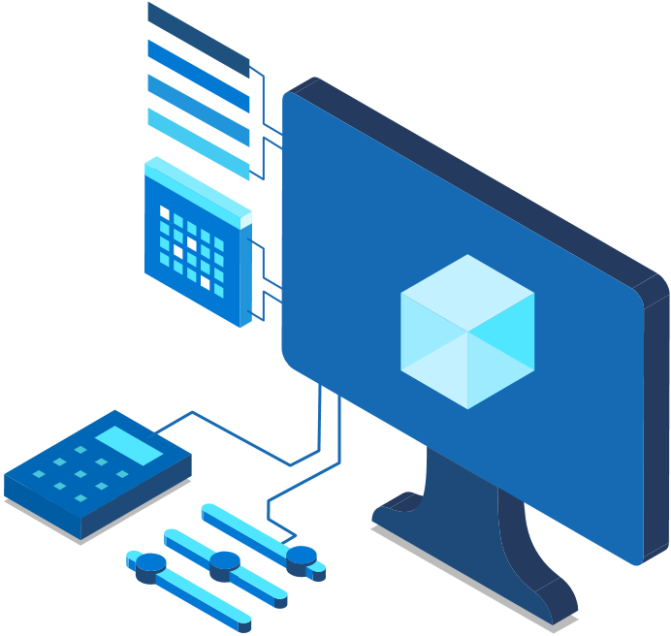


Technical Use Cases
1
Near-real time big data analytics solutions
Near-real time logs analytics solutions for your observability, monitoring, and security data
Replace infrastructure-based log search solutions
Complement with your SIEM product
Accelerate your AI Ops journey
IoT Analytics solution
Connected devices
Build cloud base historian
Analytical SaaS solutions
Notes:
Build near-real time big data analytics solutions – for analyzing your append-only data like events, click stream, logs, etc. For example, telco customers using data explore for powering their customer experience reporting to understand the network congestions and call quality. We have customers analyzing their click stream data to optimize their ad.
Build near-real time logs analytics solutions for your observability, monitoring, and security data
Replace infrastructure-based log search solutions
Complement with your SIEM product
Accelerate your AI Ops journey
Build IoT Analytics solution for your Connected devices or bring your manufacturing data to cloud and build a historian
If you are an ISV and providing analytics services to your customers. Build your solutions on Data Explore, its flexible building single tenant or multi-tenant solutions

Slide 11
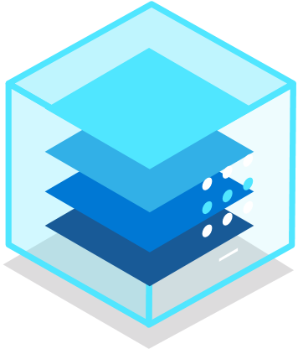


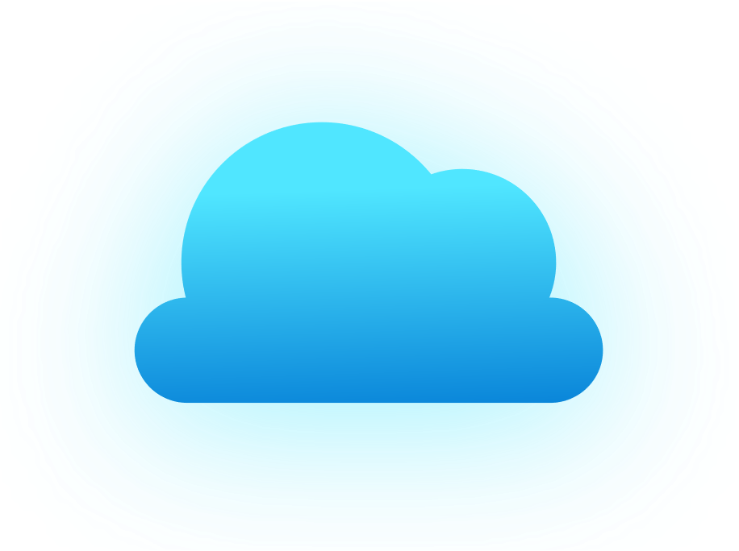
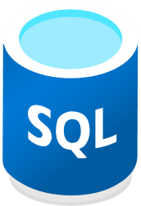

Data Explorer pool architecture
Azure
OSS
Applications
Azure portal/Studio
Apps (via ARM)
Apache Spark
Query, control commands
Create, manage
Azure Data Factory
Apps via APIs, REST, SQL (TDS), ODBC, JDBC)
Apps via APIs
Power BI
Data management
SSD
Logstash plugin
ADX UI (+ Dashboards)
Kafka sync
Power Automate, Flow
IoT Hub
Active data connections
Azure Data Factory
Event Hub
Jupyter Notebooks
Grafana, Redash.io
Event Grid
Apache Spark
Azure Storage
Customer Data Lake (blob / ADLS Gen2)
Ingested Data
SQL
Cosmos DB
Azure Monitor
Notes:
Data Explorer pools implement a scale out architecture by separating the compute and storage resources. This enables you to independently scale each resource and, for example, run multiple read only computes on the same data.
Data Explorer pools consist of a set of computes running the engine that is responsible for automatically indexing, compressing, caching, and serving distributed queries.
They also have a second set of computes running the data management service responsible for background system jobs, and managed and queued data ingestion.
All data is persisted on managed blob storage accounts using a compressed columnar format.
Data Explorer pools support a rich ecosystem for ingesting data using connectors, SDKs, REST APIs, and other managed capabilities.
It offers various ways to consume data for adhoc queries, reports, dashboards, alerts, REST APIs, and SDKs.
Finally, its supports querying data from SQL, CosmosDB, Azure Monitor and Data Lake.

Slide 12
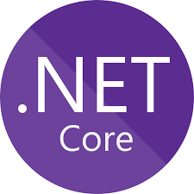



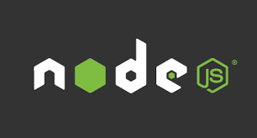




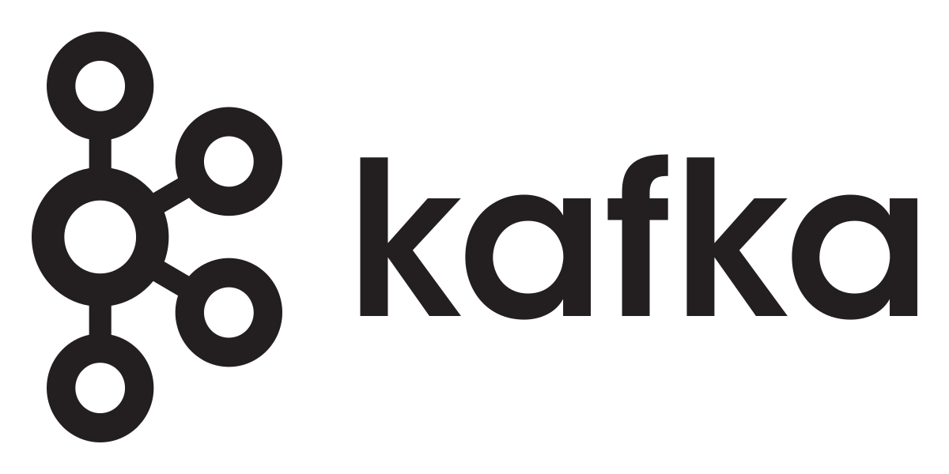




Data Management and Ingestion
1
SDKs
Managed pipelines
Data Explorer pool
Connections
Batching
Synapse Data Explorer
Engine
Data Management
Ingestion
Connection & plugins
Management
Tools
One Click Ingestion
LightIngest
Notes:
You can ingest data in Data Pool in many ways.
Using our SDKs
Use managed pipelines where Data Explorer will automatically read the data from IoT Hub, EventHub or Storage\Data Lake
Use any of the 1st party connectors and agents to push data from Kafka, Spark, Logstach, PowerApp, FluentBit, and Telegraph agents
Use Azure Data Factory\Synapse Pipelines to bring data from wide variety of sources
Data Explorer support automated batching of the data for efficient ingestion and can ingest up 200 MB/sec csv files per 16 cores compute. It support wide variety of formats such as JSON, Parquet, Orc, Avro and more.
Limitations with current Data Explorer in Synapse:
IotHub and Event Grid managed pipelines are not supported when the workspace is created under Managed Vnet.

Slide 13
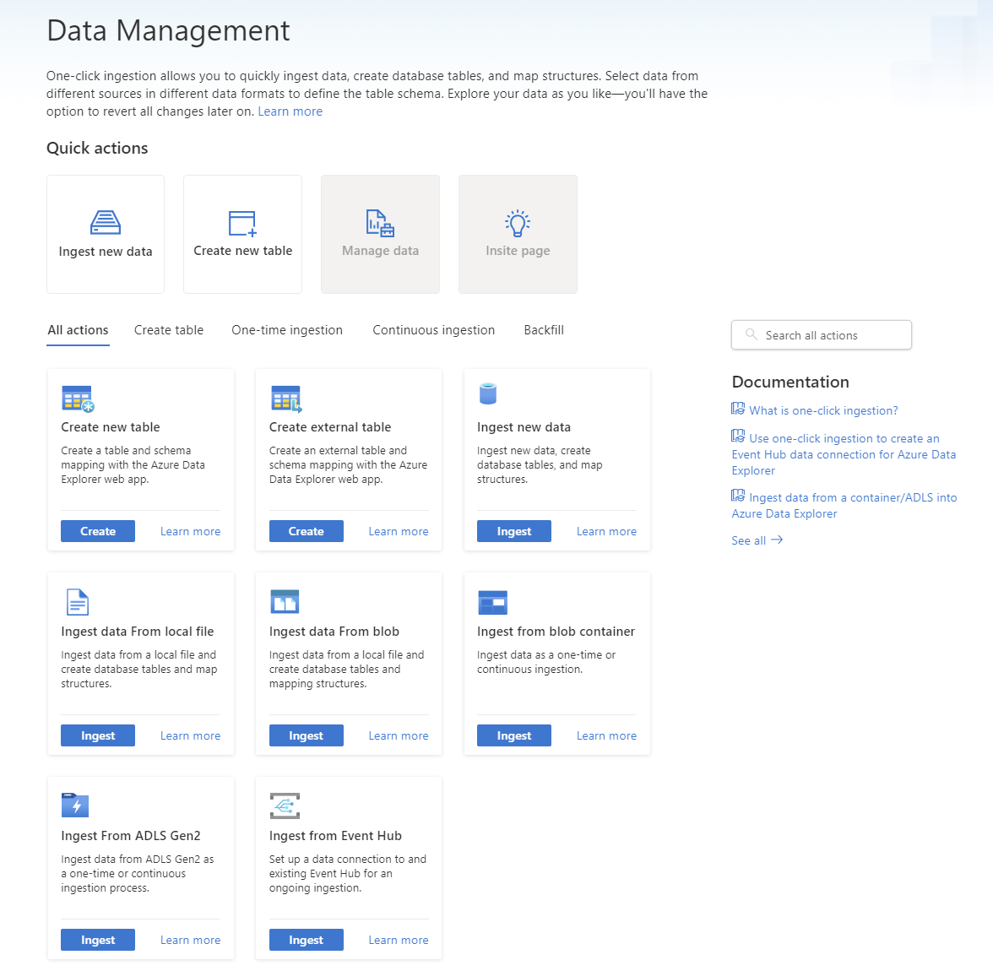
ADX Web UI One-Click (wizard)
1
Friction free on-boarding of your Azure data sources to Data Explorer
Get data from Azure Data Lake, Blob, Event Hub, or local file
Infer the schema automatically from source
Create table and mapping automatically from source
Generate custom code to start ADX project with one of the supported SDKs
Manage data-policies (e.g. retention, batching policies, streaming)
Get insight on your data management
Ingest one-time data or create connection for continuous data ingestion
Continuous (EventHub/EventGrid), one time or backfill (LightIngest)
Data Explorer Pools
Event Grid
Event Hubs
Azure Data Lake Storage
Notes:
Slide is self-explanatory

Slide 14

Distributed Query Engine
1
Storage and Compute isolated
Auto compression, indexing, optimization
Semi-structure (JSON) and unstructured data (free text) indexing
Data is sharded, distributed, cached across nodes on local SSDs and persisted on cloud storage
Ingestion time-based partitioning + custom partitioning
Hot and cold data management
Table level caching + results set caching
Workload management
Partitioning
Materialized views
External tables for Blob, Data Lake, and SQL
Notes:
The storage and compute are decoupled this provides flexibility and elasticity to managed your workload better and get the right price performance.
Data Explorer indexes the semi structured data (JSON) and unstructured data (free text) that makes running queries very performant compared to other analytical engines on this type of data. By default, every field is indexed during the data ingestion (low-level encoding policy allows one to fine tune or disable the index for the specific fields). The scope of the index is a single data shard. The implementation of the index depends on the type of the field.
(optional deeper explanation)
String column index - The engine builds an inverted term index for the string column values. Each string value is analyzed and split into normalized terms, and an ordered list of logical positions (i.e. containing record ordinals) is recorded for each term. The resulting sorted list of terms and their associated positions is stored as an immutable B-tree.
Numeric column index - For the numeric columns (these also include DateTime and TimeSpan columns), the engine builds a simple range-based forward index. The index records the min/max values for each block, for a group of blocks and for the entire column within the data shard.
Dynamic column index - To index a dynamic field, the ingestion process enumerates all “atomic” elements within the dynamic value (property names, values, array elements) and forwards them to the index builder. Other than that, dynamic fields have the same inverted term index as the string fields.
Rest all capability enables you to build a rich and highly performant solution on Data Explorer engine.

Slide 15
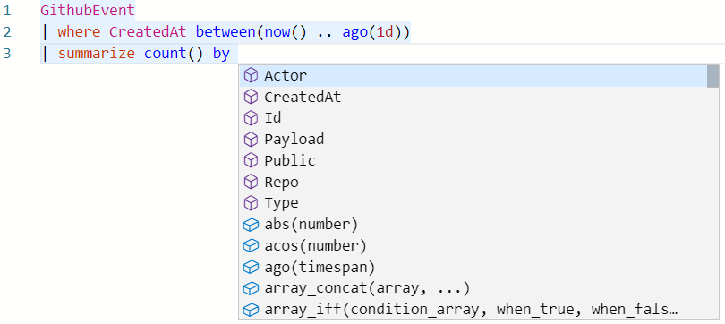
Kusto Query Language (KQL)
1
Simple and powerful
Rich rational query language (filter, aggregate, join, calculated columns, and more)
Built-in full-text search, time series, user analytics, geospatial, and machine learning operators
Out-of-the box visualization
Easy-to-use syntax + Microsoft IntelliSense
Highly recognizable hierarchical schema entities
Extensible
In-line Python and R
T-SQL
Notes:
KQL has large growing community with a rapid adoption of Azure Monitor, Application Insights, Sentinel, Azure Data Explore and other Microsoft offerings. The language is well designed for easy-to-read syntax and provide a smooth transition from simple one-liner to complex data processing. This allows us to provide rich intellisence support compared to SQL language and provides rich set of language construct and built-in capabilities for Aggregations, Time Series, and User Analytics; that aren’t available in SQL for exploring telemetry data at a rapid pace.
We do support In-line Python, R, and T-SQL

Slide 16
Advanced Analytics – Built-in & Extendible
1
Out of the box
Auto Clustering for Diagnosis and RCA
Anomaly Detection
Regression
Forecasting
Time Series Analysis library
Distributed Custom Code Execution
Distributed Python and R execution
Custom code is embedded in the KQL query
Spark Integration
Native Spark connector for heavy duty model training
Operationalize model into DX pool for scoring
Tools
Jupyter Integration with KQL Magic
Python, Java SDKs
Notes:
Slide is self-explanatory

Slide 17
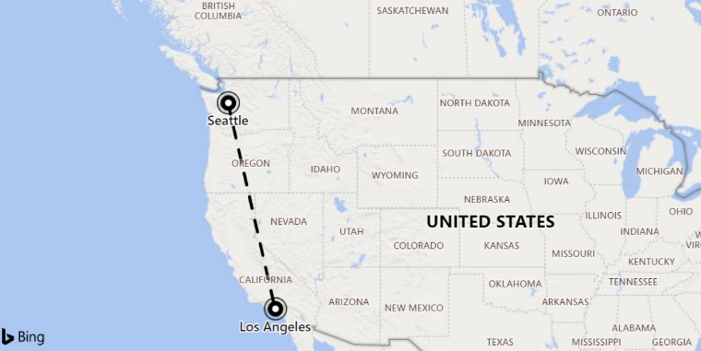
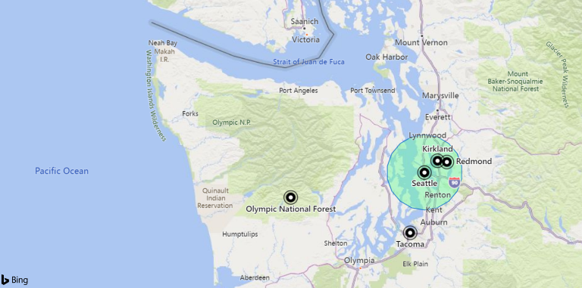
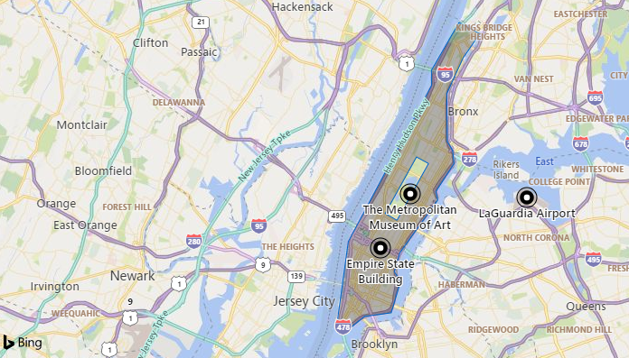
Geospatial query
1
Support for geospatial clustering
Transformation from coordinates to geospatial clusters and back
Support for Geohash, S2 and H3 cells
Distance
Calculate the distance between two points or a point and a line
Contains
Check whether a point is in a given circle or polygon
Advanced features
Densification to control shape edges, geodesics or straight lines
H3-Rings
Geospatial coordinates are interpreted as represented per the WGS-84 reference system.
Notes:
Geohash
https://docs.microsoft.com/en-us/azure/kusto/query/geo-point-to-geohash-function
https://docs.microsoft.com/en-us/azure/kusto/query/geo-geohash-to-central-point-function
Points in circle
https://docs.microsoft.com/en-us/azure/kusto/query/geo-point-in-circle-function
Distance
https://docs.microsoft.com/en-us/azure/kusto/query/geo-distance-2points-function

Slide 18
Cross Queries
1
Between Data Explorer databases and pools
Query SQL pool from Data Explorer pool
Query Azure Monitor from Data Explorer pool
Query CosmosDB from Data Explorer pool
Query Data Lake from Data Explorer pool
Notes:
You may have scenarios where you may want to create multiple Data Explorer pools for storing different types of data or host different pool is different regions or different divisions in your company many have their own Data Explore pools. In all these scenarios cross database\pool enable you to easily cross query between database, between data explore pools in same region or other regions.
Data Explorer is integrated with rest of the Azure ecosystem, in cases where you don’t want to ingest the data in Data Explorer pool – you can query it easily from SQL, Azure Monitor, CosmosDB, and Data Lake.

Slide 19

Data Sharing
1
Share data within the company
Load balancing
Data-as-a-service
Hub and Spoke model
Chargeback
Ingest
Query
Query
Leader
Follower
Follower
No Maintenance
In-Place Data Sharing
No data pipeline to maintain
Near real-time updates
Symbolic link
R/W
R/W
R/W
R
R/W
DB1
DB2
DB3
DB3
DB4
Compute
Compute
Azure Blob Storage
Azure Blob Storage
Notes:
Thanks to the separation of storage and compute in Data Explorer pool. You can have one Data Explorer pool for ingesting and querying the data and share the databases with multiple Data Explorer pools. This enables you to load balance, offer data-as-a-service, build Hub and Spoke model, or chargeback to you internal teams.
Its all automated and real-time caching, you don’t need to maintain any pipeline.

Slide 20

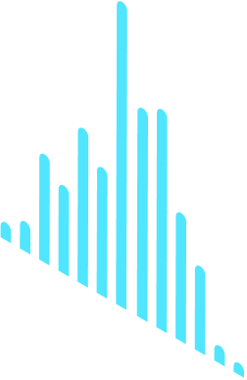
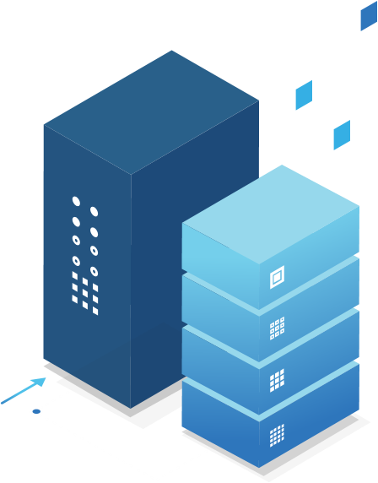

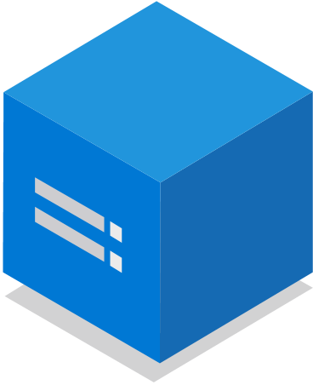


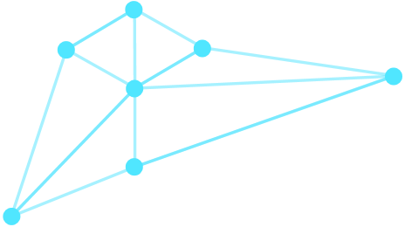
Pricing
Freely explore your data - not bound by cost per query
Predictable cost
Decoupled storage and compute
Easy to switch between SKUs after provisioning
Ability to pause the compute
Dedicated capacity
Three main components
Compute Synapse vCores meters
Storage Synapse Data Stored meters
Network Passthrough meters
Notes:
Slide is self-explanatory

Slide 21

Enterprise Ready – Mission Critical
Azure Active Directory Integration
Availability Zones
Role based authorization
Auto Scale-Up/In
Synapse Managed Vnet with Data Exfiltration Protection
Globally available
Encryption with customer managed keys
CI/CD Integration
Monitoring
Automated provisioning
Build Azure Policy Support
Notes:
Data Explorer is enterprise ready will all the key capabilities you need get to production.

Slide 22
Thank you

